Slide 1
Tree-based Non-Parametric Models 2

Slide 2
Contents
Regression Tree
White Box and Black Box
Bagging and Boosting
Bagging and Random Forest
Boosting: AdaBoost and XGBoost

Slide 3
Regression Tree
Like decision trees, regression trees are formed by a series of questions asked about the data, leading to a predicted outcome. Each question is called a “split”, and the outcome is a leaf of the tree.
Splitting Criteria: The model starts with the entire dataset and selects a variable to split the data on. The split is chosen based on minimizing the sum of squared residuals (the difference between the observed and predicted values).
The prediction for each leaf node is typically the mean (or sometimes the median).

Slide 4
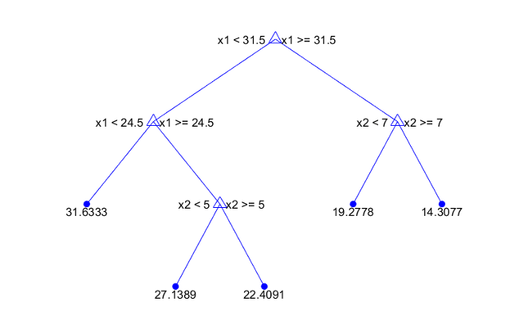
Regression Tree

Slide 5
White Box and Black Box
White Box Method
The White Box or Transparent Model approach, refers to models that are inherently interpretable. These models provide clear explanations about how they make predictions or decisions.
Black Box Method
The Black Box method refers to models that are complex and whose internal decision-making processes are not readily interpretable or understandable by humans.
Linear Regression
Decision Trees
Rule-based Systems
Ensemble Models
Deep Learning Models

Slide 6
Bagging and Random Forest
Bagging (Bootstrap Aggregating):
Bagging is an ensemble learning technique that aims to reduce the variance of a ML model by combining multiple instances of the same model trained on different subsets of the training data.
Key points about Bagging:
Each model in the ensemble is trained independently.
Bagging helps reduce overfitting and increase model stability.
Random Forest is a popular implementation of bagging, where decision trees are used as base models.

Slide 7
Bagging and Random Forest
The bootstrap method has an equal probability of randomly drawing each original data point for inclusion in the resampled datasets.
The procedure can select a data point more than once for a resampled dataset. This property is the “with replacement” aspect of the process.
The procedure creates resampled datasets that are the same size as the original dataset.

Slide 8
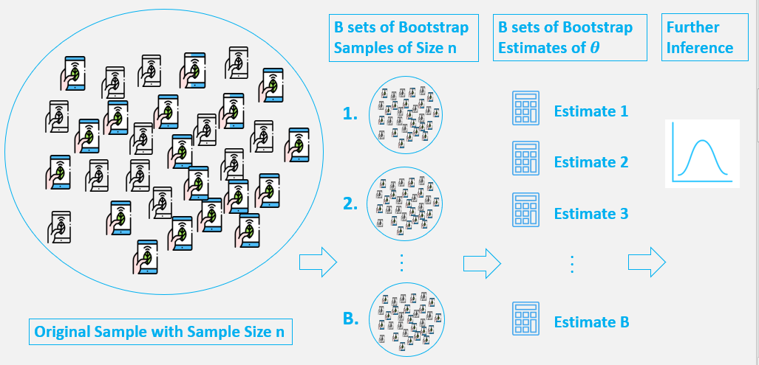
Bagging and Random Forest

Slide 9
Bagging and Random Forest
Common method of aggregation is either averaging for regression problems or majority voting for classification

Slide 10
Bagging and Random Forest
The process involves the following steps:
creating multiple bootstrap samples (random samples with replacement) from the original training dataset.
training a base model (often a simple model like a decision tree) on each bootstrap sample.
the final prediction is obtained by averaging (for regression) or taking a majority vote (for classification) of the predictions from individual models. In other words, it is obtained by aggregating the predictions from each base model.

Slide 11
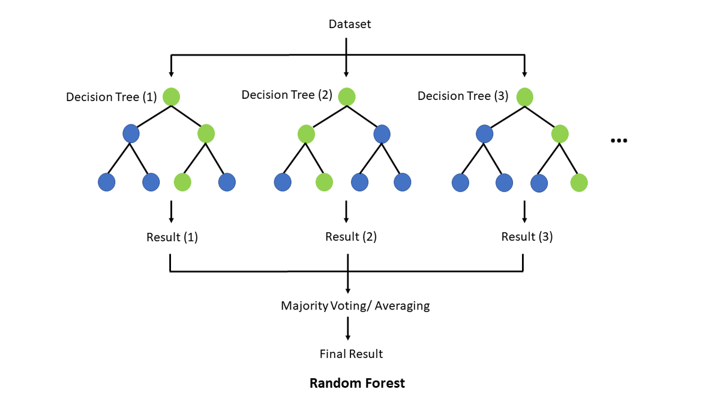
Bagging and Random Forest
Random Subsets of Features:
In Random Forest, instead of considering all features for a split at each node in a decision tree, only a random subset of features is considered

Slide 12
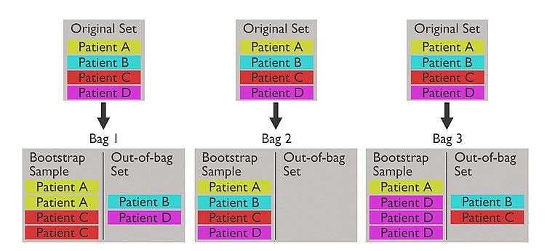
Bagging and Random Forest
Bagging fraction is about 63.2%
Out-of-bag error is the error computed by the entries not in the bag
Explaination of bagging fraction: https://medium.com/analytics-vidhya/bootstrapping-and-oob-samples-in-random-forests-6e083b6bc341

Slide 13
Feature importances
Feature importances in a Random Forest model refer to the degree to which each feature contributes to the model’s predictions.
They are calculated based on the decrease in impurity within each tree in the forest.
Note: Impurity-based feature importances can be misleading for high cardinality features (many unique values).

Slide 14
Boosting
Boosting is another ensemble learning technique that focuses on improving the accuracy of a model by combining weak learners sequentially.
Unlike bagging, boosting assigns weights to instances in the dataset and adjusts them based on the model's performance. Misclassified instances receive higher weights, and subsequent models focus more on these challenging instances.
The final prediction is a weighted sum of predictions from individual models.
Key points about Boosting:
Models in boosting are trained sequentially, and each model corrects errors made by the previous ones.
Boosting aims to reduce bias and can achieve high accuracy by focusing on difficult-to-classify instances.
Common boosting algorithms include AdaBoost, Gradient Boosting, and XGBoost.

Slide 15
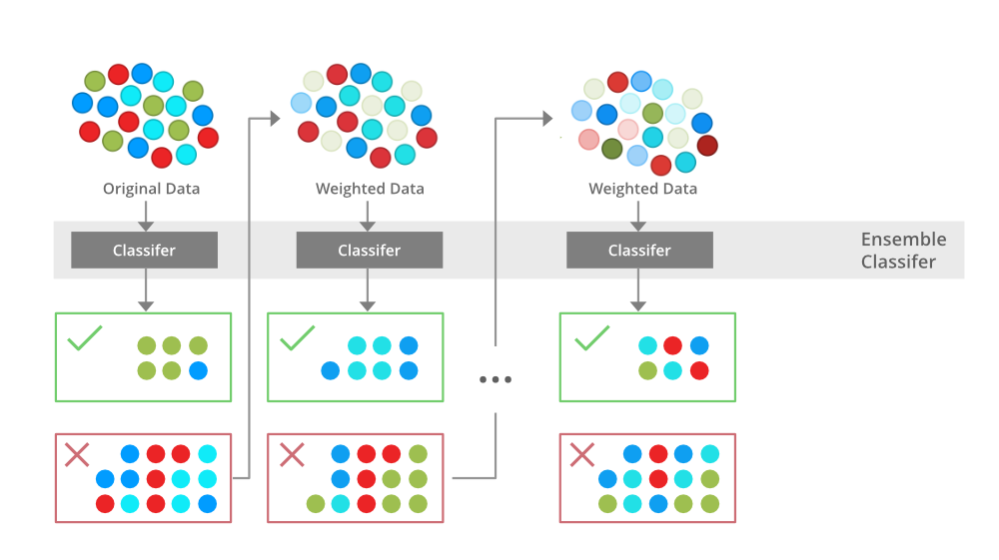
Boosting

Slide 16
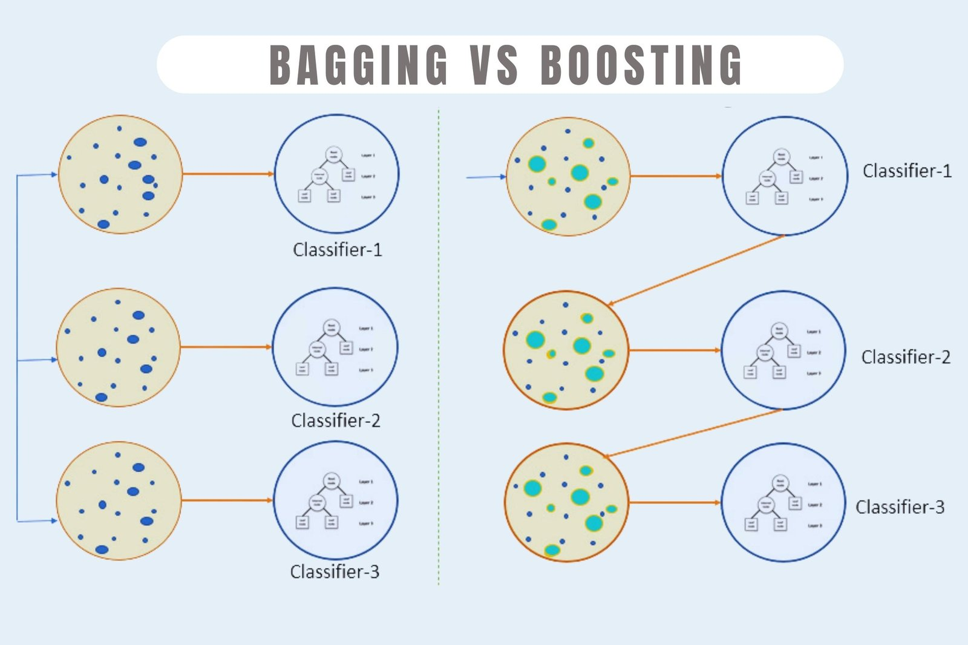
Boosting

Slide 17
AdaBoost
AdaBoost, short for Adaptive Boosting, is a machine learning algorithm that is used for classification. Usually, AdaBoost is presented for binary classification, although it can be generalized to multiple classes

Slide 18
AdaBoost
For first round, set weights for entries to be w=1/n
Resampling according to their weights
Train a classifier / Stump
Calculate Total Error
Calculate Performance
Update weights & Normalized weight
Repeat steps 2-6 until number of rounds is reached

Slide 19
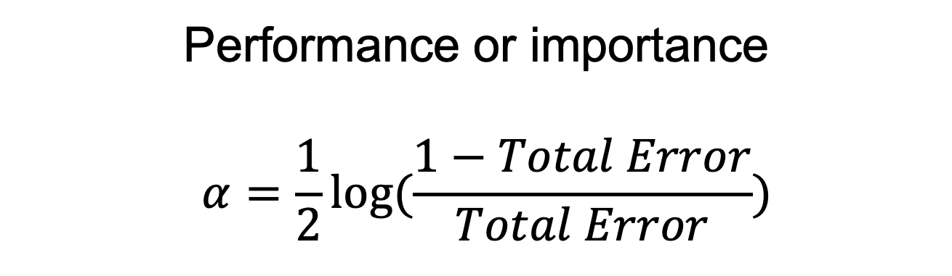
AdaBoost
Total Error = sum over all weights of misclassified entries
The weights of well-classified entries are neglected.
Performance or importance
$$α=\frac{1}{2}log⁡(\frac{1−Total Error}{Total Error})$$
New weight = Weight * exp(performance) → misclassified records
New weight = Weight * exp(-performance) → correctly classified records

Slide 20
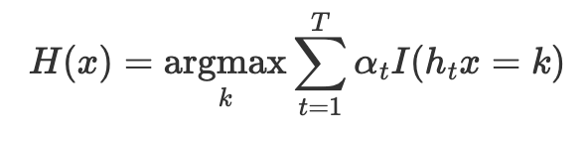
AdaBoost
The output of the final prediction is determined by a weighted majority vote across all the trained learners
Final prediction picked by ∑ α_i * (predicted value from estimators of each round)

Slide 21
AdaBoost
For AdaBoost Regressor:
Total error become residual
Performance become loss function, normally is linear loss function
The output of the final prediction is weighted averaged

Slide 22

XGBoost
XGBoost, short for eXtreme Gradient Boosting, is a well-known algorithm and an open-source framework. It’s an implementation of gradient boosted decision trees designed for speed and performance.
Regularization: XGBoost introduces L1 (Lasso regression) and L2 (Ridge regression) regularization terms in the cost function to control over-fitting, which is not directly available in AdaBoost. This regularization feature helps to improve the model's generalization capabilities.
Tree Pruning: XGBoost uses a depth-first approach to grow trees up to a max depth, and then starts pruning back the splits that have the least importance. This is in contrast to the greedy algorithm more commonly used in other tree ensemble methods, which might stop growing the tree prematurely.

Slide 23
Additional video
Additional video resources for a better understanding of these two techniques:
[1] https://www.youtube.com/watch?v=tjy0yL1rRRU
[2] https://www.youtube.com/watch?v=sN5ZcJLDMaE

Slide 24
Thank You

Slide 25
Thank You

